Slide 1
Predictive Model for
Major Crimes in Toronto
Abdulrahman H, Ethan A, Ethan M, Larry Y, Munachimso E

Slide 2

WHAT OUR DATA IS
Source: Toronto Police Service “Major Crime Indicators” open dataset, police-reported incidents across all 158 neighbourhoods in Toronto.
Size: We started with about 452,949 crime records and, after cleaning missing values, removing “NSA” locations and duplicates, we used 388,111 rows for modeling.
Time & Location: Each row has when and where the crime happened (occurrence year, month, day of week, hour, division, neighborhood, and coordinates).
Target: We predict MCI_CATEGORY, one of five major crime types (e.x; Assault, Robbery, Auto Theft) based on these temporal and spatial features.

Slide 3
THE PROBLEM & OUR SOLUTION
Problem:
Toronto has hundreds of thousands of reported major crime incidents spread across roughly 158 neighbourhoods with changing patterns year after year
Police data is mostly descriptive and not predictive, thus it’s hard to know which major crime is most likely to occur and to proactively allocate resources and police
The raw dataset contains missing values, NSA areas, duplicates, and class imbalance making it too large and noisy for manual analysis
Solution:
We built a machine learning pipeline which cleans the toronto police major crime indicators data, it prepares for modelling using TIME_OF_DAY, division, premises type, and neighbourhood.
After testing multiple algorithms, we selected a Decision Tree classifier that reaches about 67.81% accuracy and an F1-score of 0.67, clearly better than random guessing between five crime categories
The final model is deployed as a RESTful Flask API that takes simple inputs (year, month, day of week, hour, division, premises) and returns a predicted crime category, enabling future apps and dashboards for real-time crime-risk planning

Slide 4
CLEANING TABLES
Missing & Duplicate Values:
Removed entries with missing data from the OCC (Occurrences) columns to avoid inaccurate or incomplete records.
Removed Non-Relevant Columns:
HOOD_140 & NEIGHBOURHOOD_140:
  The dataset mentions two types coding system for neighbourhood location label data (_140 and _158). With _140 being the older outdated system code.
OCC_DOY (Occurrence Day of the Year)
  Redundant information alongside OCC_DOW (Day of the Week) and OCC_DAY.
REPORT_ * (Dare, Year, Month, Day, DOY, DOW, Hour):
  The report time stamps do not matter when attempting to predict when another major crime is occuring.
UCR_CODE & UCR_EXT:
  Redundant information, due to having MCI_CATEGORY and OFFENSES for identifying crime type.
“x” and “y”:
  We do not 100% know what this means. There is not mention of it in the documentation for the data. Therefore no usage.
Not Specific Area
The Toronto Police Service changed how they recorded their data in 2014. Causing some neighbourhoods to have a coordinate of 0, 0, which are identified as Not Specified Area.
Neighbourhood mention NSA has been dropped due to the fact they are too vague when training data.
Notes:
Cleaning the Tables
Before modeling the data, we must first remove any unnecessary or missing values apart of our data set to keep it consistent. With the follow methods were apply to our data set.

Slide 5
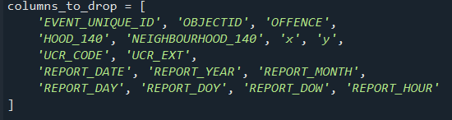
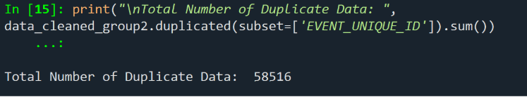
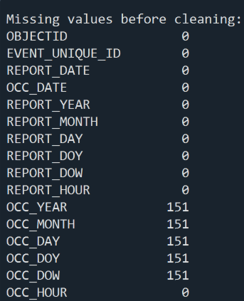
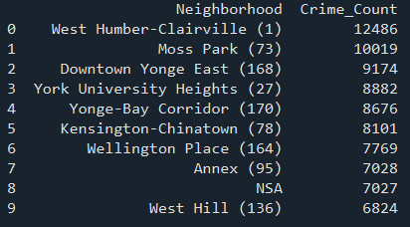
CLEANING TABLES - IMAGES
Notes:
Cleaning the Tables
Before modeling the data, we must first remove any unnecessary or missing values apart of our data set to keep it consistent. With the follow methods were apply to our data set.

Slide 6
WHY WE KEPT THE REST OF THE COLUMNS
OBJECT_ID & EVENT_UNIQUE_ID
They have the individual id for each crime record.
Helps when removing duplicates crimes which are present in the database.
OCC_* (DATE, YEAR, DAY, DOW, HOUR):
Occurrence dates fields help pinpoint when crimes are likely to happen.
Using the most accurate sources of data in regards when a crime occured.
LOCATION_TYPE & PERMISES_TYPE:
Important because they can describe where a crime took place at (apartment, house, street).
From the data we can determine that certain crimes can be more common in certain areas.
MCI_CATEGORY & OFFENCE:
These are central to the problem because our objective is to predict the crime category.
  MCI_CATEGORY: The main category of crime data (assault, grand theft auto, robbery).
  OFFENCE: Provides more detail description on what type of sub-category the crime induce. (Robbery - Taxi)
HOOD_158 & NEIGHBOURHOOD_158:
Since our model also predicts where a crime is likely to occur, having the neighbourhood data is important to knowing which neighbourhood it is.
The _158 neighbourhood coding system is the current and accurate version of used by Toronto.
LONG_WGS84 & LAT_WGS84:
Contains the exact geographic coordinates of where a crime occurred.

Slide 7
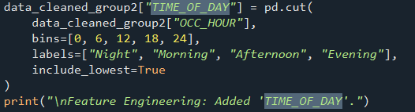

FEATURE ENGINEERING
Features:
TIME_OF_DAY
  Dividing hours of a day into four categories depending on the time: morning, afternoon, evening, and night.
  Divides the time of day into a meaningful predictable segment to help the model learn the patterns in crime with time of day.
One-Hot Encoding
  Made categorical features (DIVISION, OCC_DOW, etc.) into numerical format that makes machine learning models understand.

Slide 8
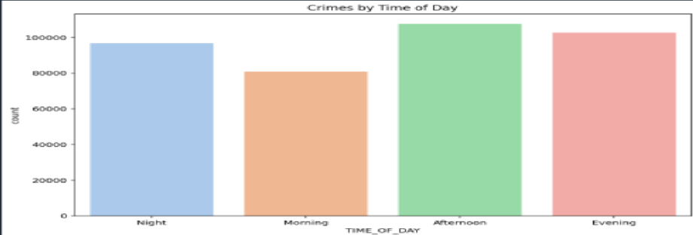
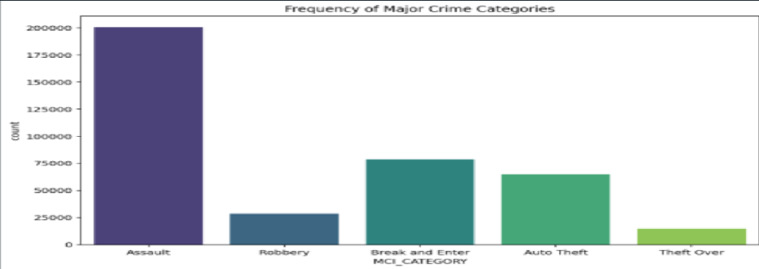
Visualizing Data

Slide 9
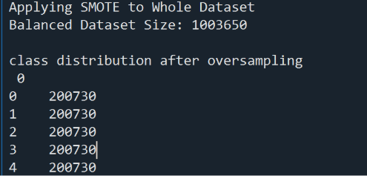
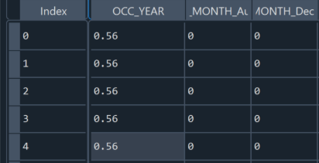
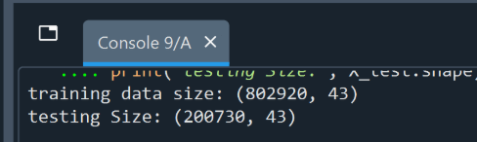
BALANCING DATA
Our Process:
When initially skimming through the dataset, in the MCI_CATEGORIES section, Assaults took over 53%. With the next section, Break and Enter, having 18% of data around 300k+ records over 10+ years.
To balance the date, we used SMOTE to oversample the minority data to avoid data leakage and make more accurate predictions without having a biased towards assault.
Then we had to use normalization to scale the OCC_YEAR due to years (2014… 2025) being large numbers compared to the rest of the columns (. OCC_HOUR is 1-24).
  So we’ll be converting the OCC_YEARS to decimal numbers to keep it in a smaller range for the model.
Finally, we Split the Data for 80% for Training & 20% for Testing. Using Stratified Sampling (stratify=Y) to make sure both training and testing sames have the same percentage of each crime type.

Slide 10
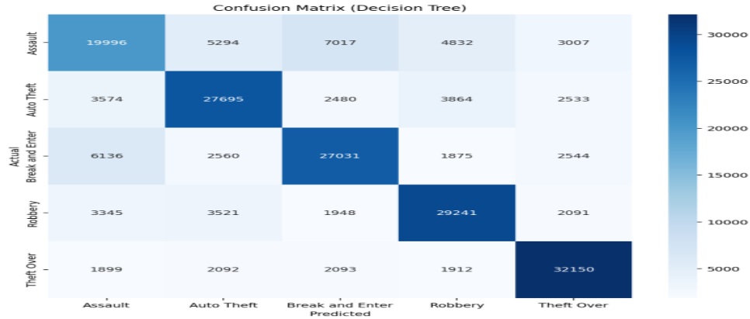
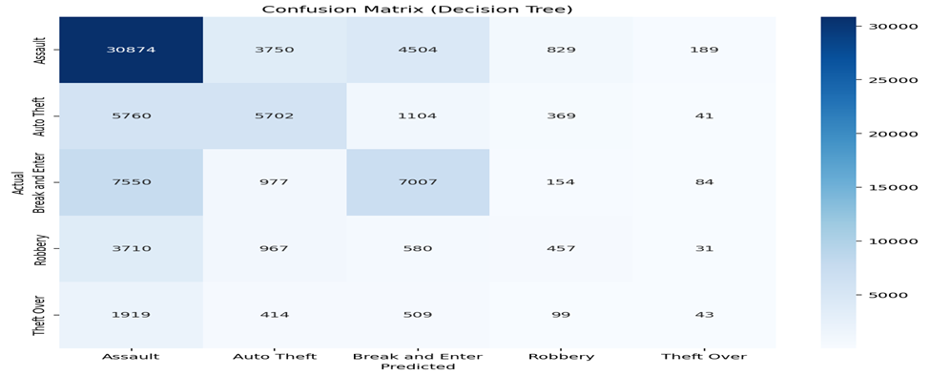
Confusion Matrix
Balanced Dataset:
Original Dataset:
Notes:
To show the exact state where the model begins to get confused.
Predicts well, sometimes confused Break an Entry with Assault

Slide 11
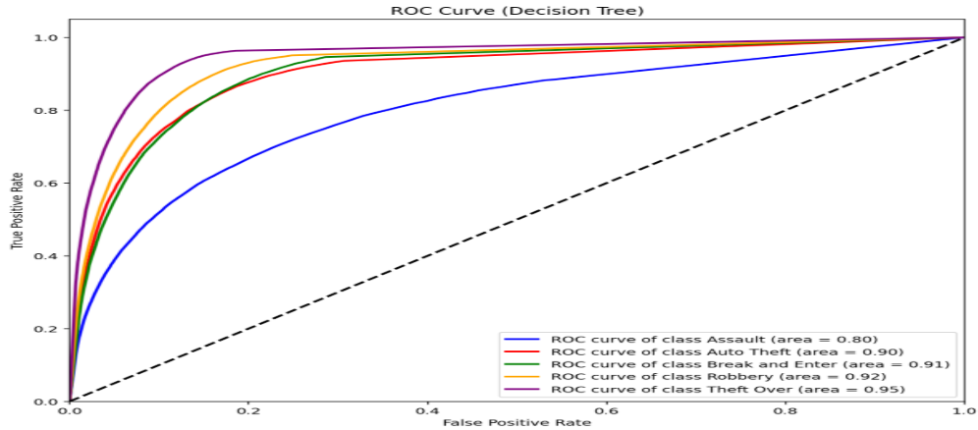
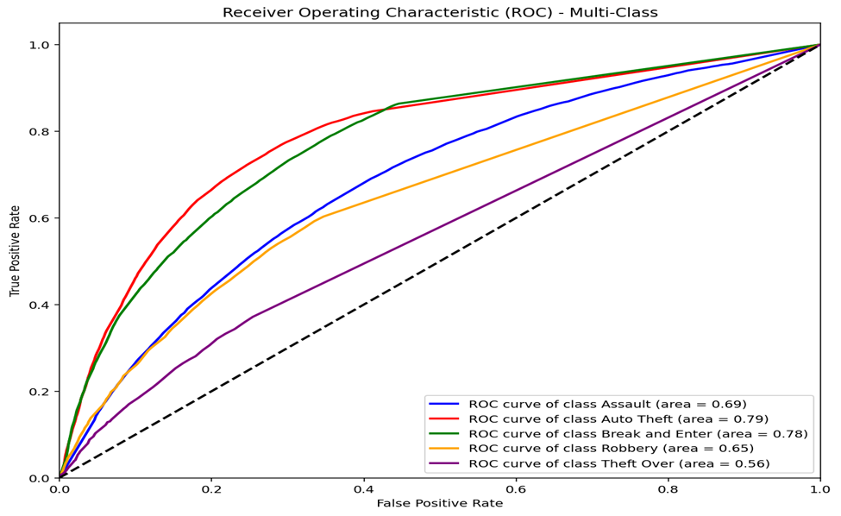
ROC Curve
Balanced Dataset:
Original Dataset:

Slide 12
RUN APP

Slide 13
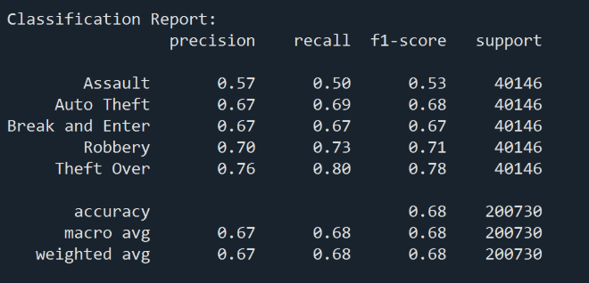
CONCLUSION
In Conclusion….
We cleaned and prepared over 388k Toronto major crime records, engineered time, location-based features, and explored multiple models to predict the most likely crime category for a given situation.
Our best Decision Tree model achieves 67.81% accuracy with an F1-score of 0.67 and is deployed as a Flask REST API that can return crime risk predictions from simple inputs.
This pipeline shows how open police data can move from raw CSVs to a working predictive tool, and it can be extended with better balancing, new features, and a front-end dashboard to support real-time planning.

